Slide 1
Donatello
David, 1440-1460
Bronze, 5’2” high
Bargello Museum, Florence
QUESTION 1
Please write two to three paragraphs (single space). Think of the visual descriptions (say the obvious too), who these figures are and what stories are being told. Try to remember where these are, who may have commissioned them (if known), and what messages they are giving out.
Full complete sentences and well written. May use open book, class notes. NO ONLINE RESEARCH NEEDED
Verrocchio
Barolomeo Colleoni
1481-1495 Bronze, 13’ h.
Campo di Santi Giovanni and Paolo
Venice

Slide 2
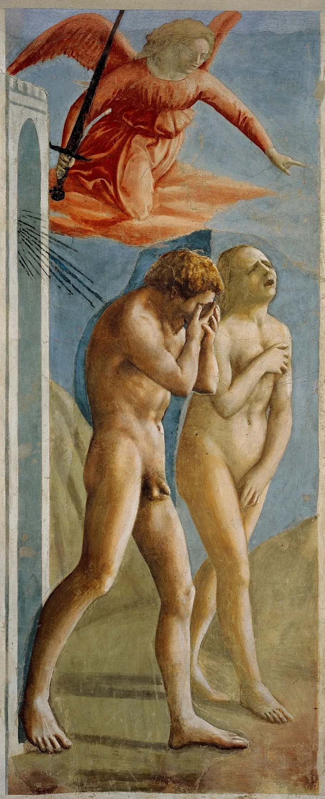
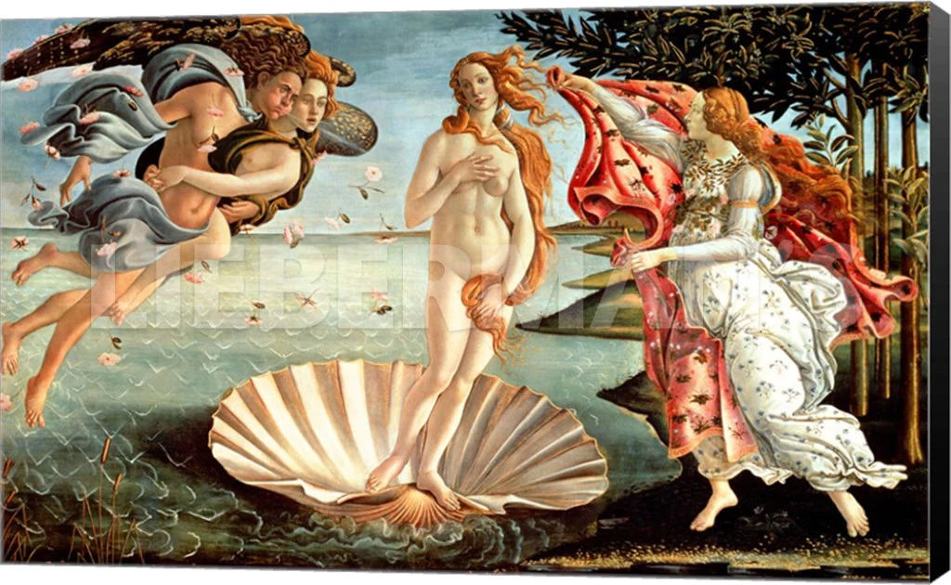
MASACCIO, Expulsion of Adam and Eve, 1424-6. Fresco. Brancacci Chapel, Florence
BOTTICELLI, Birth of Venus, 1485-6. Tempera and gold on panel. Originally for the bride’s room in a Medici country villa.
QUESTION 2: Compare and contrast these two narratives – one from the beginning of the Quattrocento, the other from the end. What are the exact narrative moments that contrast – one of expulsion, one of welcome – that help to tell the story. Remember – 3 things – visual comparison (be thorough here), historical placement, and the meaning as viewed by the original audience and determined by its original setting.

